Slide 1
Good Eating When Broke
Gary Clark

Slide 2
Goal
Which of the top 5 most popular universities in TX have the most >= 3 star ratings for restaurants nearby?
Ratings based on Yelp

Slide 3
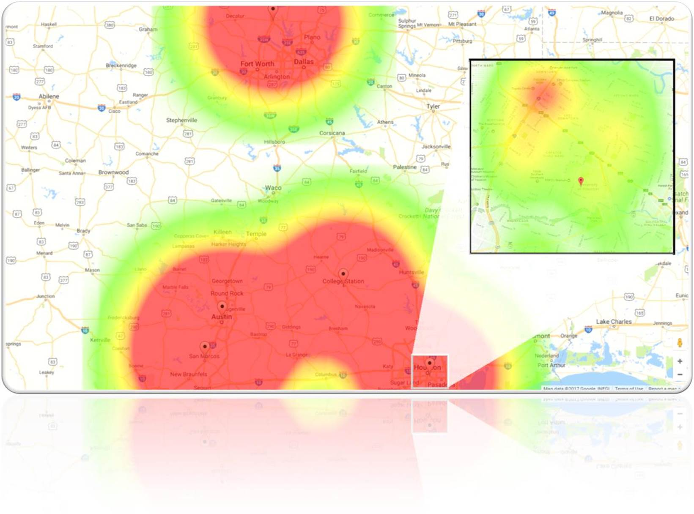
Results

Slide 4
Challenges
Yelp API
Company firewall
Used phone hotspot
Making multiple search requests to yelp businesses
Cannot hit Yelp API with parallel requests
Used a for-loop
Request limits

Slide 5
Tech
Front-End
HTML
CSS
JavaScript
Back-End
NodeJS
Data Sources
Google Maps API
Yelp Fusion API
CollegeScorecard API

